Slide 1



UNIT 2
Lesson 6
What’s with you?
Part 4

Slide 2
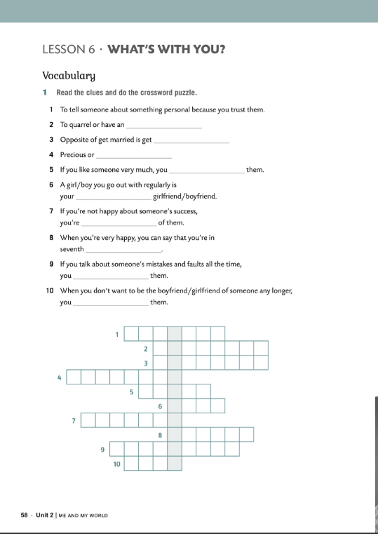
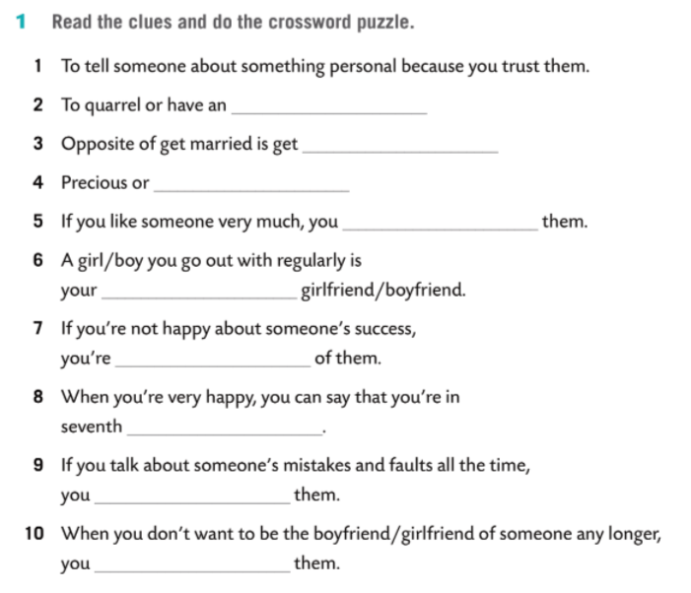
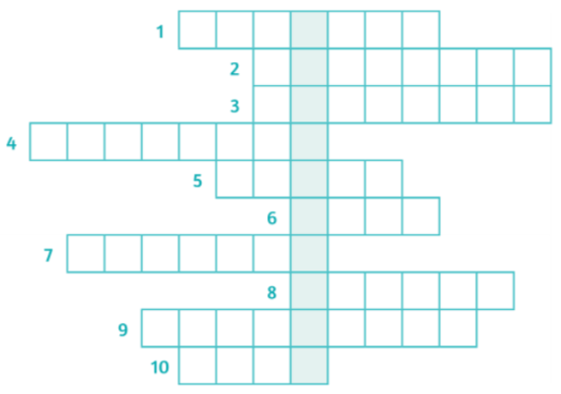
confide
argument
divorced
valuable
fancy
date
jealous
heaven
criticise
dump

Slide 3
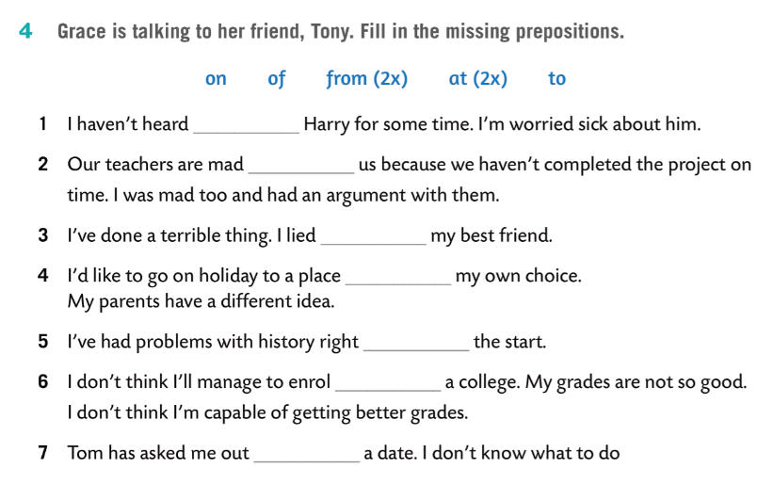
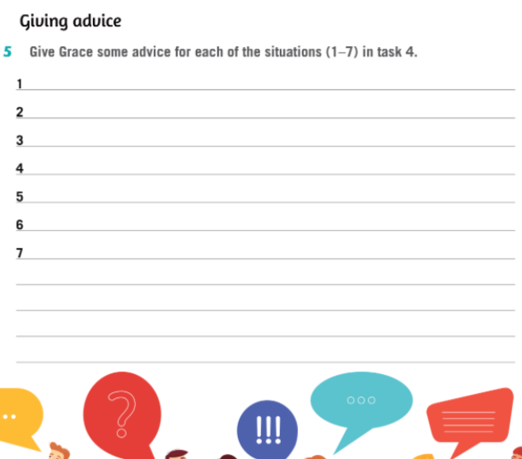
from
at
to
of
from
at
on

Slide 4
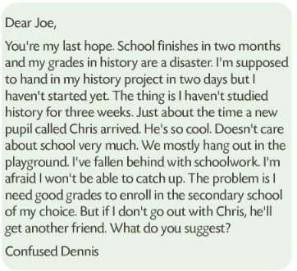
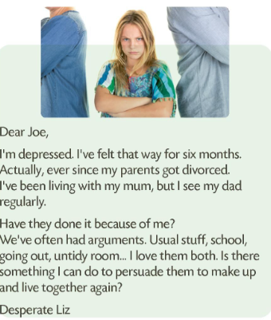
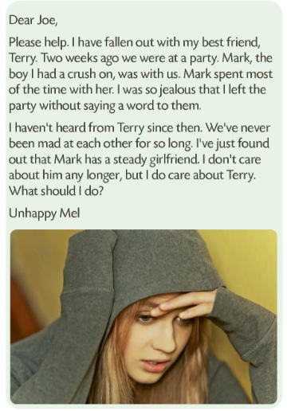
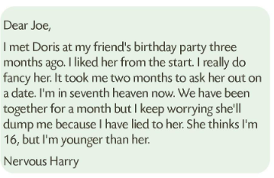
Work in small groups or pairs.
Go through the letters again. Think of some advice you would give to each of them.

Slide 5


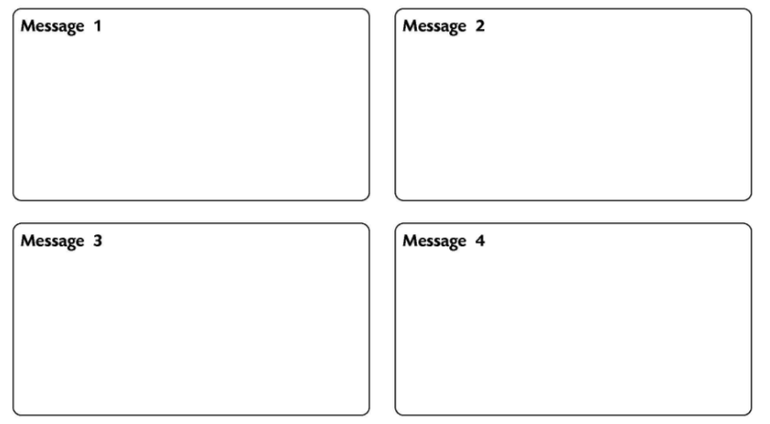
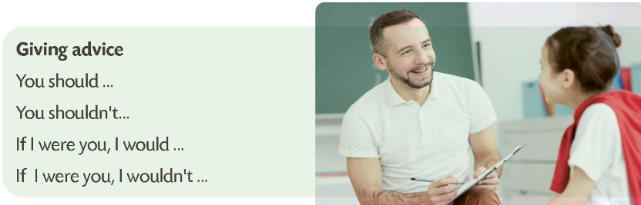
Report on the advice Joe gives to the children.
You should give your friend a ring and meet her.
Forget Chris. Focus on your school. Try to catch up with schoolwork.
If I were you, I’d get on with my life. Be there for your parents. Show them that you love them both. Be patient.
You shouldn’t tell lies. If I were you, I’d just tell her the truth.

Slide 6
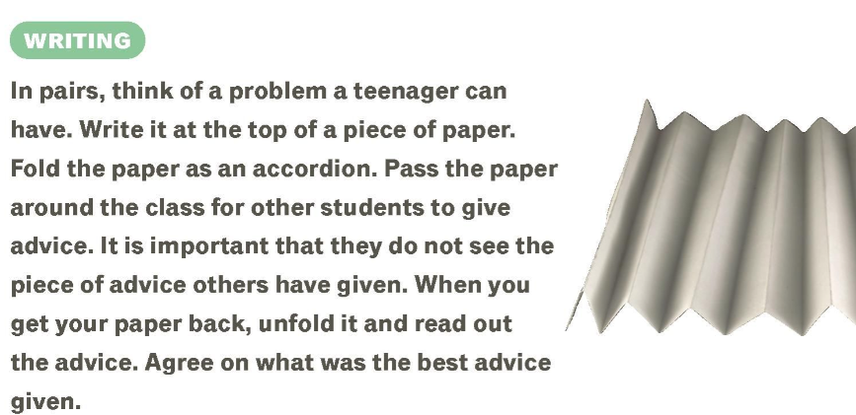


THE ART OF PODCASTING
SINCE/FOR
PHRASAL VERBS
SINCE/FOR
VOCABULARY ANAGRAMS

